Slide 1
“Let’s Build Cool Websites with ReactJS!”
Priyanka MAThur Soni, Nivedha

Slide 2
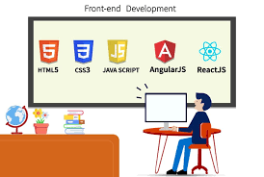
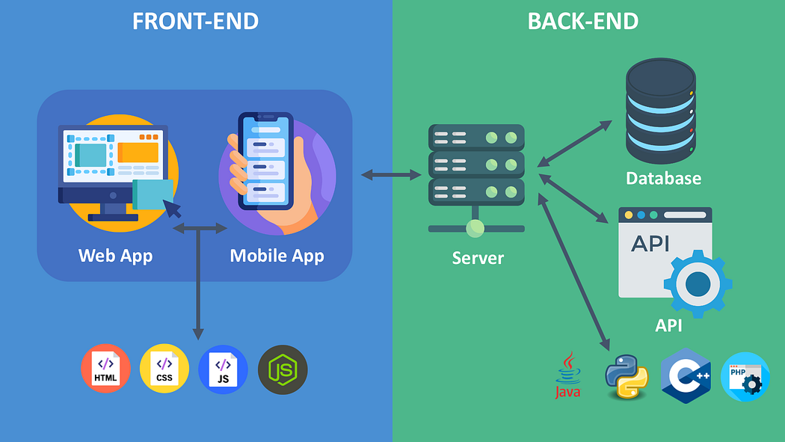
What is frontend development
Frontend development is the visible part of a website that users see and interact with.
It includes buttons, text, images, colors, and layout.
Example: When you open YouTube, the videos, buttons, search bar → all are frontend.

Slide 3
Introduction to HTML, CSS, and JavaScript
HTML (HyperText Markup Language) – Structure
HTML is the skeleton of a web page.
It defines headings, paragraphs, images, links, tables, forms, etc.
HTML = What you see (content).

Slide 4
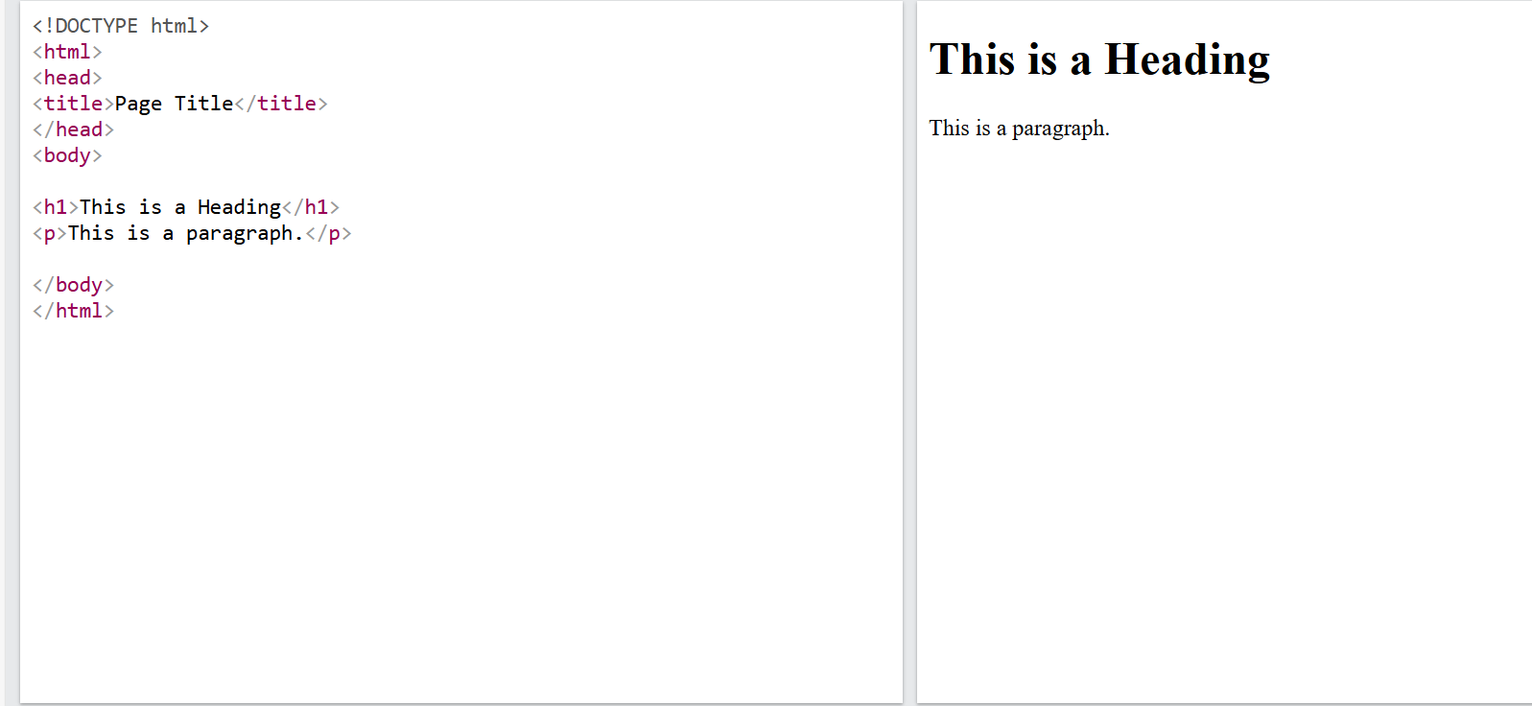
HTML example

Slide 5
Introduction to HTML, CSS, and JavaScript
CSS (Cascading Style Sheets) – Design
CSS is the clothing/decoration of a web page.
It controls colors, fonts, layouts, backgrounds, spacing.
CSS = How it looks (style)

Slide 6
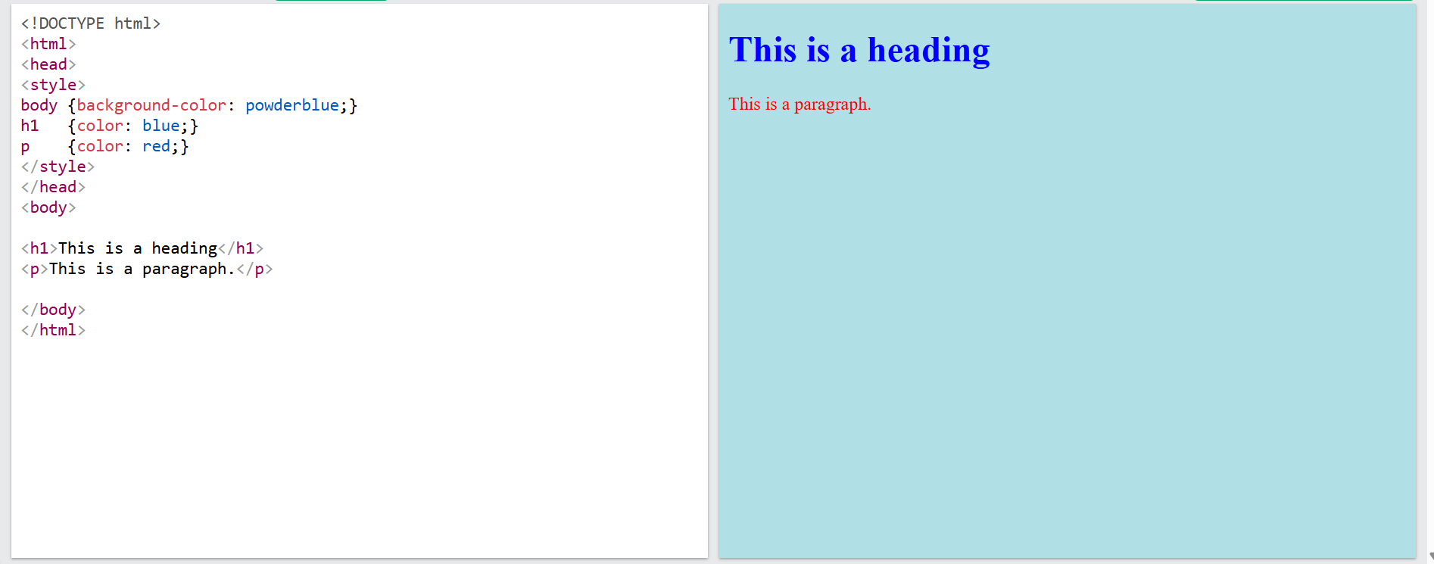
Css example

Slide 7
Introduction to HTML, CSS, and JavaScript
JavaScript – Interactivity
JavaScript makes web pages dynamic and interactive.
It can respond to clicks, inputs, animations, validations.
JavaScript = How it behaves (interactivity)
Example: Playground | MDN

Slide 8
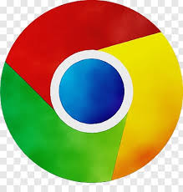


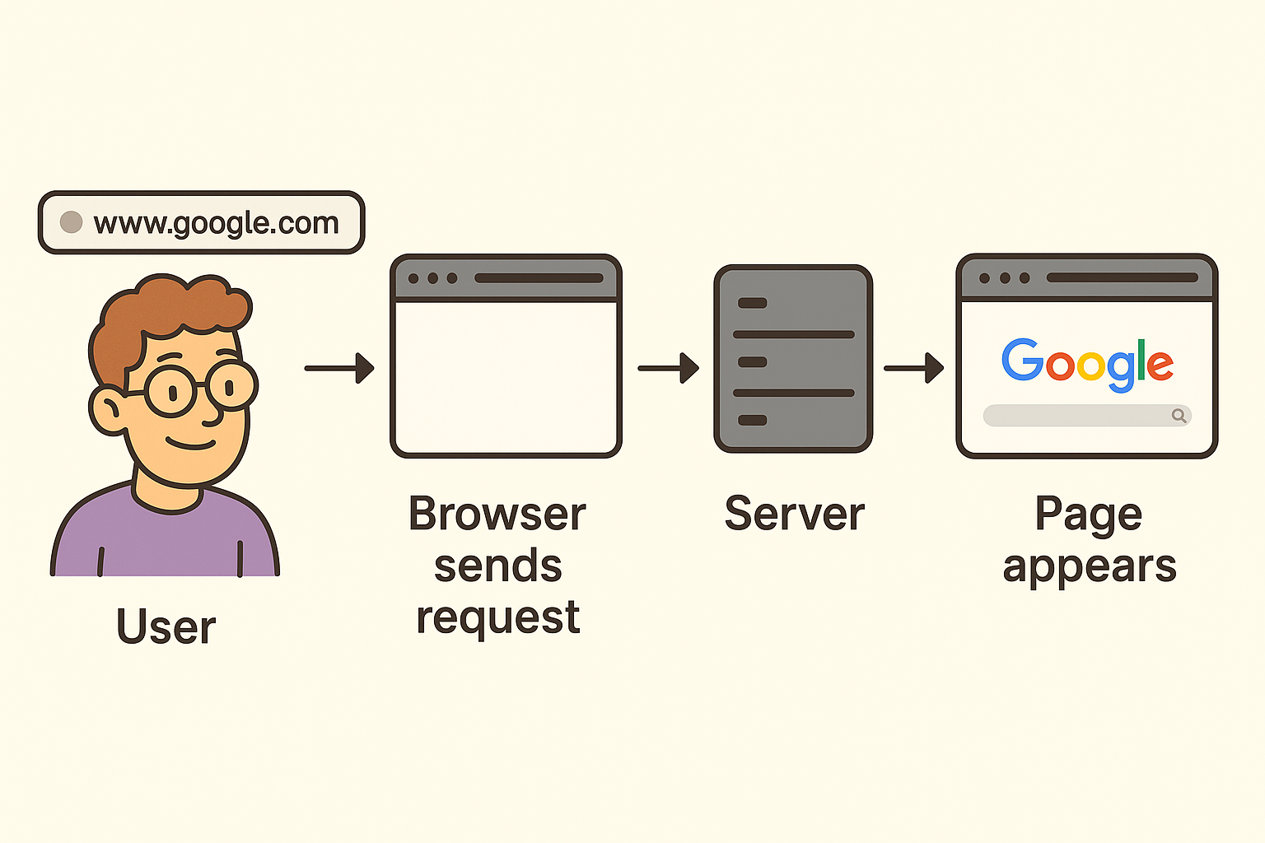
How the Web Works
Browser -
A browser is the tool you use to visit websites. When you type www.google.com in the address bar, the browser sends a request.
Server
The server is a powerful computer that stores websites. When your browser asks for a page, the server sends back the HTML, CSS, and JavaScript files

Slide 9
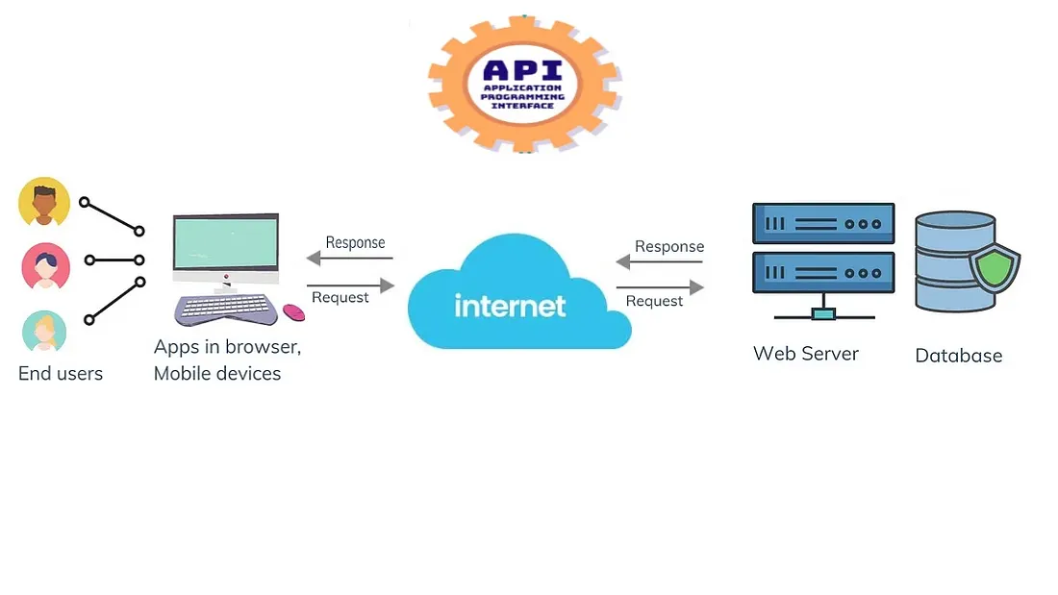
How the Web Works
APIs (Application Programming Interfaces)
APIs are like messengers that allow different apps or services to talk to each other.
Example: When a website shows Google Maps, it uses the Google Maps API to fetch data.

Slide 10
Developer Tools
Built inside Chrome (Right click → Inspect).
Used by developers to:
- Inspect elements (see the HTML & CSS behind a page).
- Debug JavaScript (find and fix errors).
- Check responsiveness (how a website looks on mobile/desktop).

Slide 11
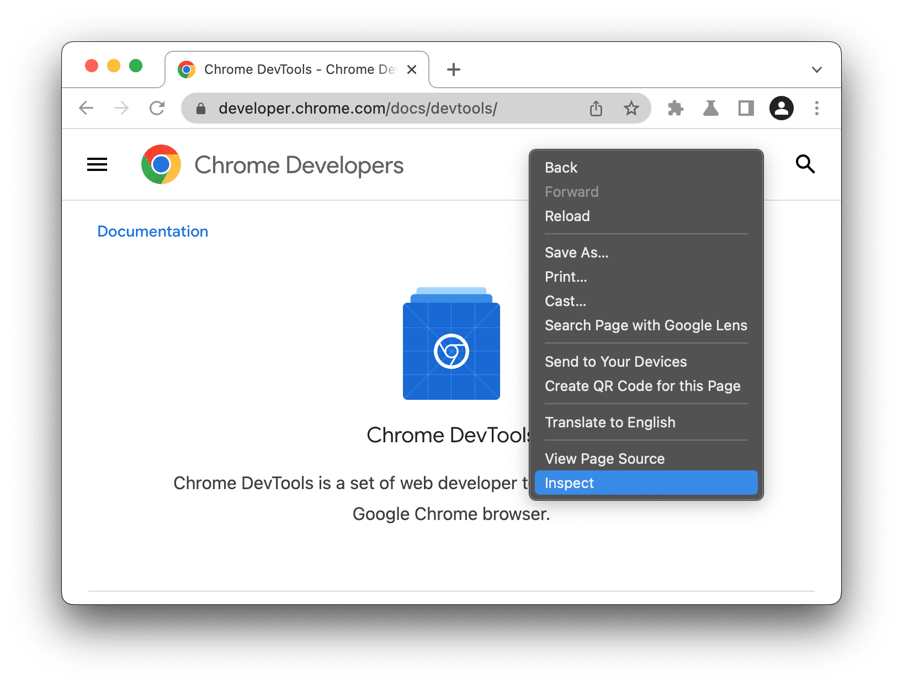
Developer Tools

Slide 12
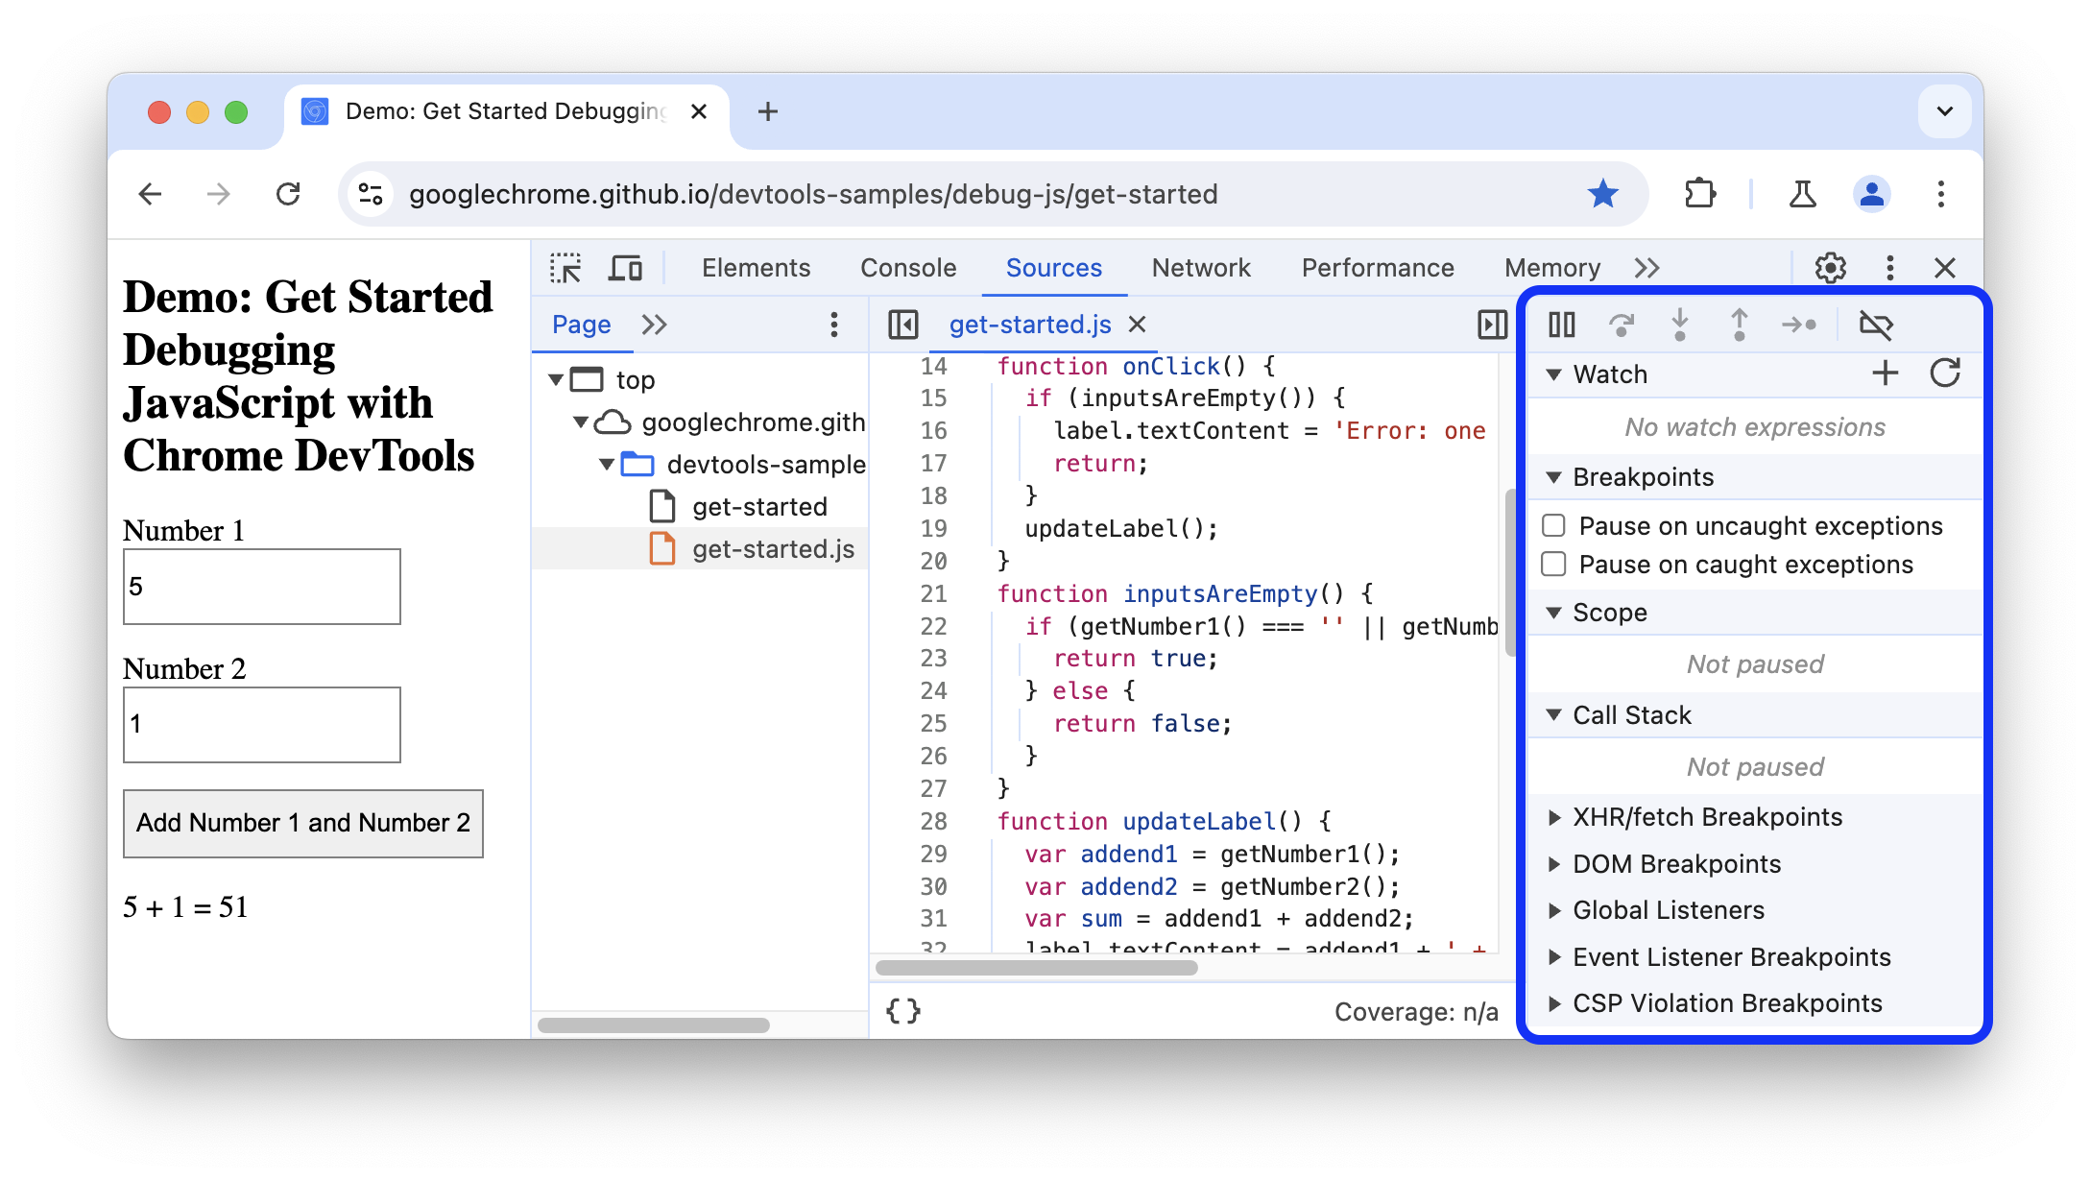
Developer Tools

Slide 13
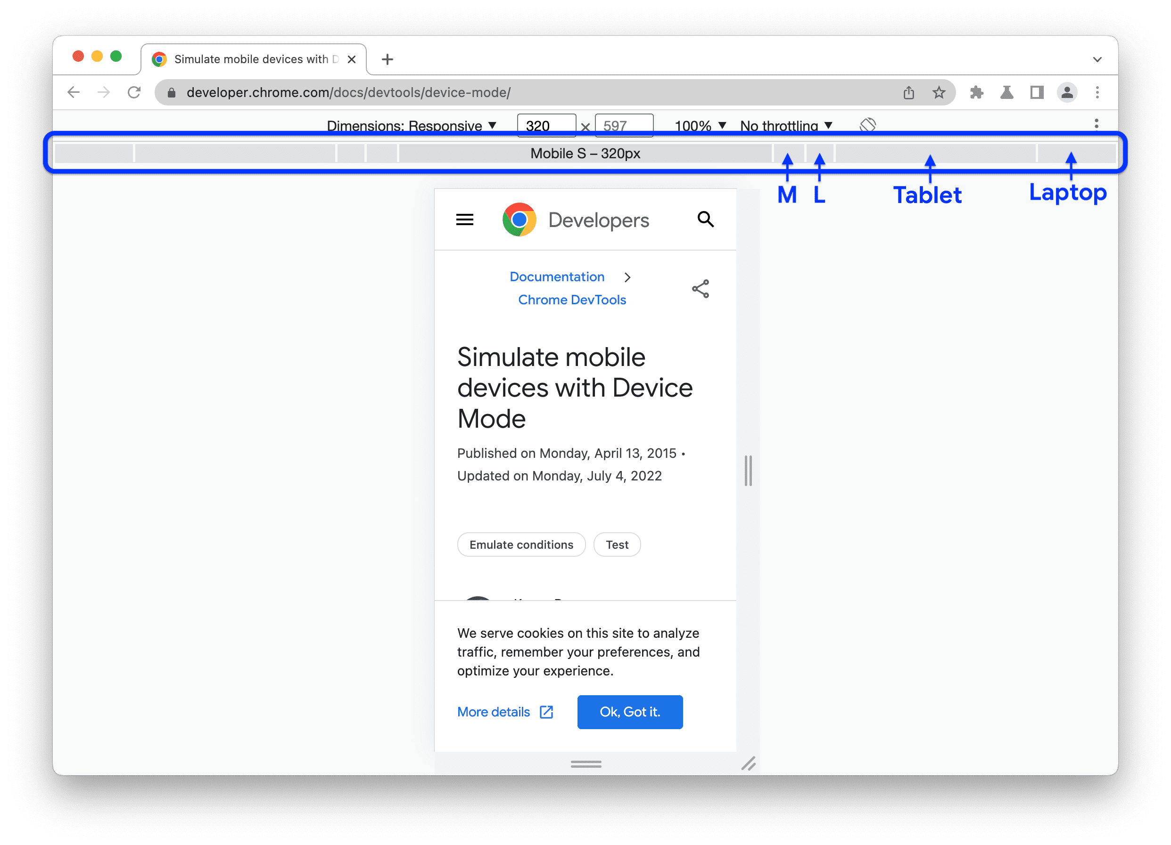
Developer Tools

Slide 14
Using VS Code
Visual Studio Code (VS Code) = a free code editor for writing programs.
Supports HTML, CSS, JavaScript, and many more languages.
Features:
- Extensions (to make coding easier).
- Themes (customize look).
- Built-in terminal (run commands).

Slide 15
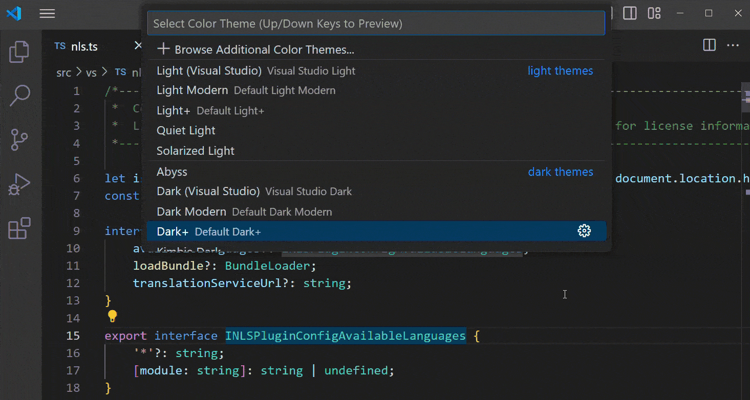
Using VS Code

Slide 16
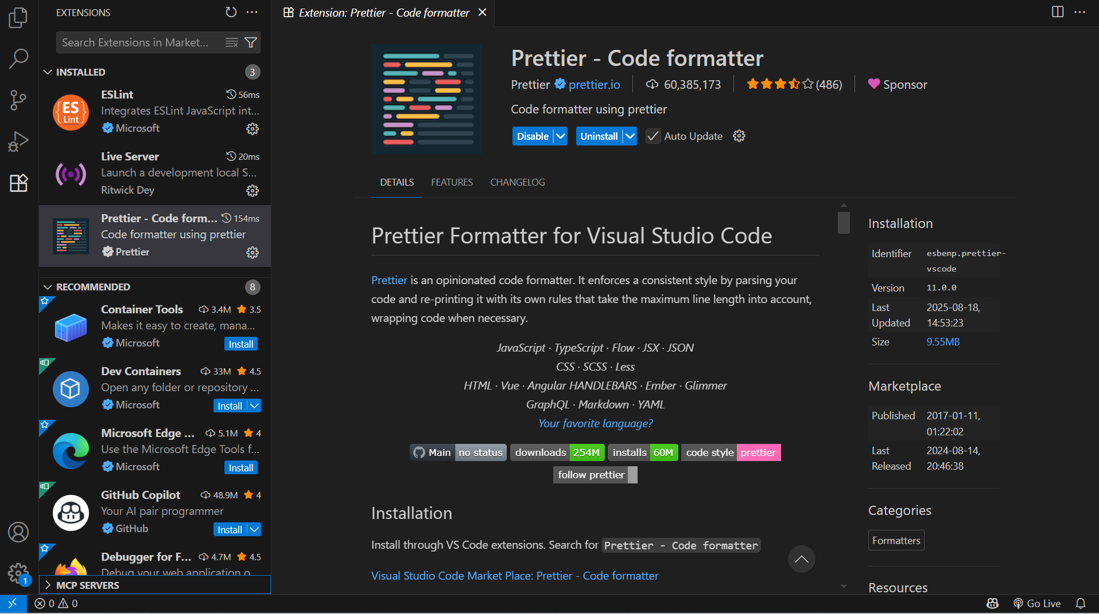
Using VS Code

Slide 17
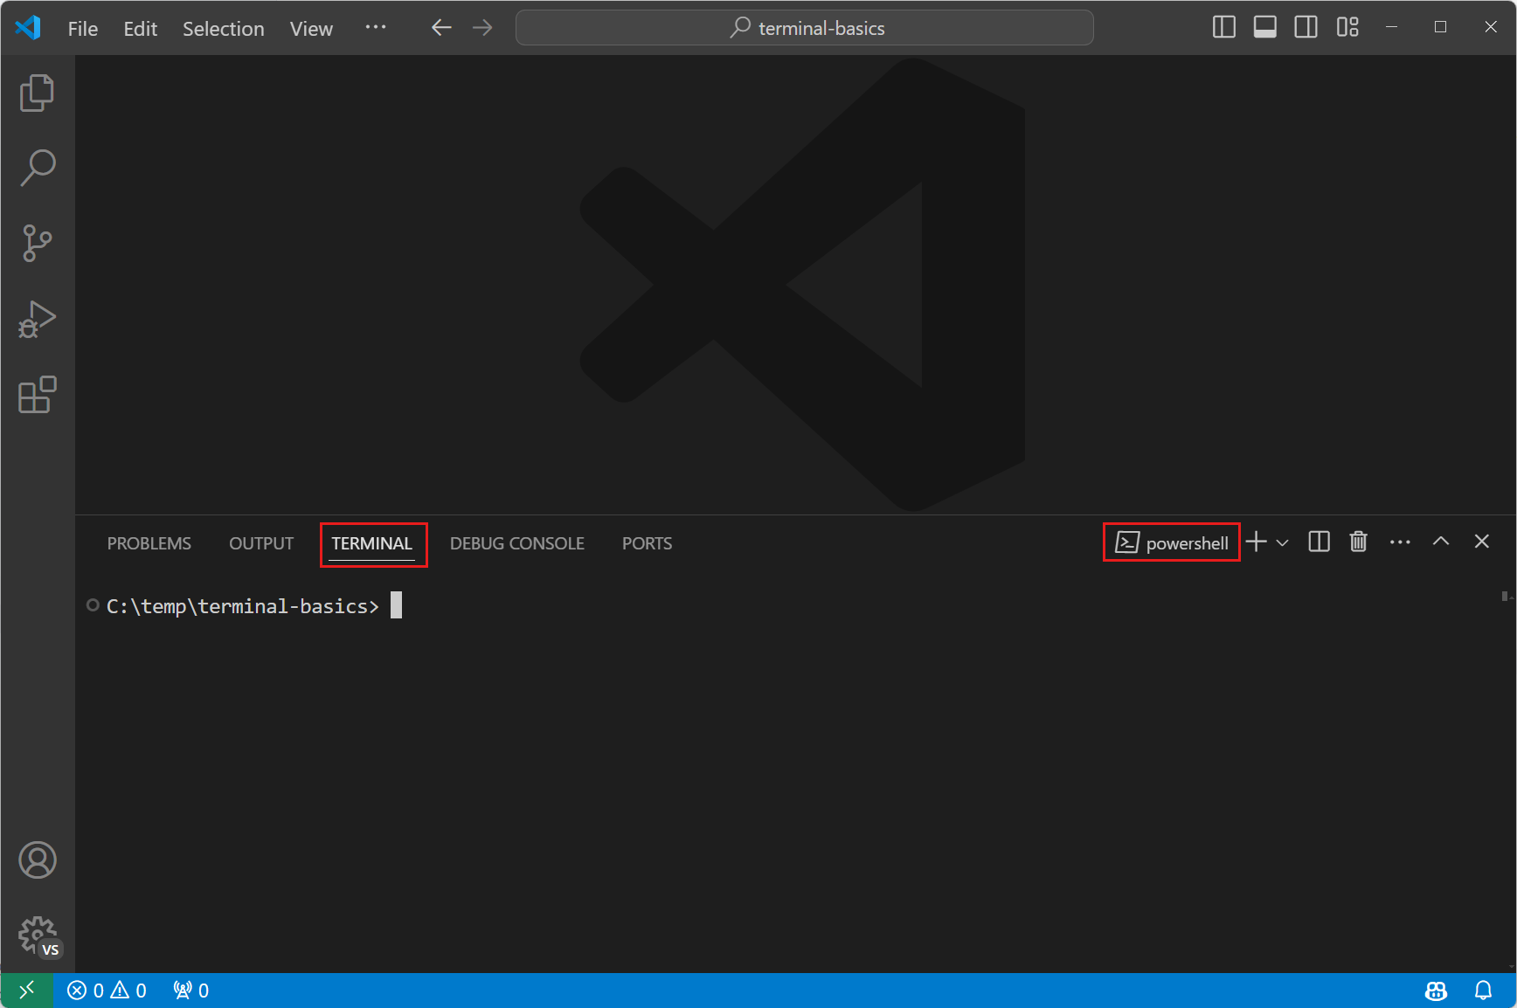
Using VS Code

Slide 18
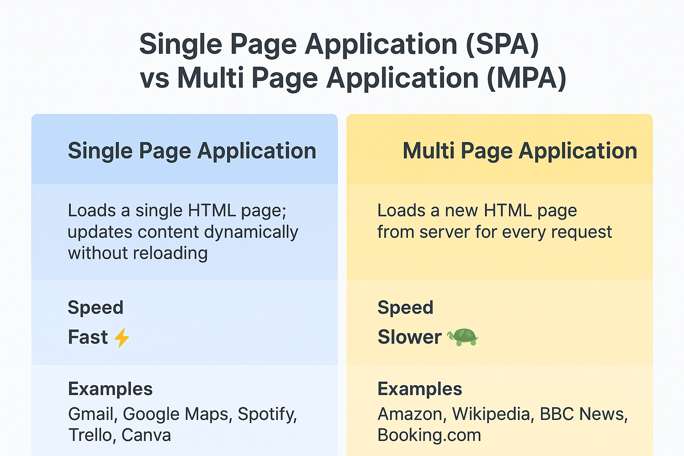
Slide Title, Segoe UI, 24pt, Max. 2 Lines

Slide 19
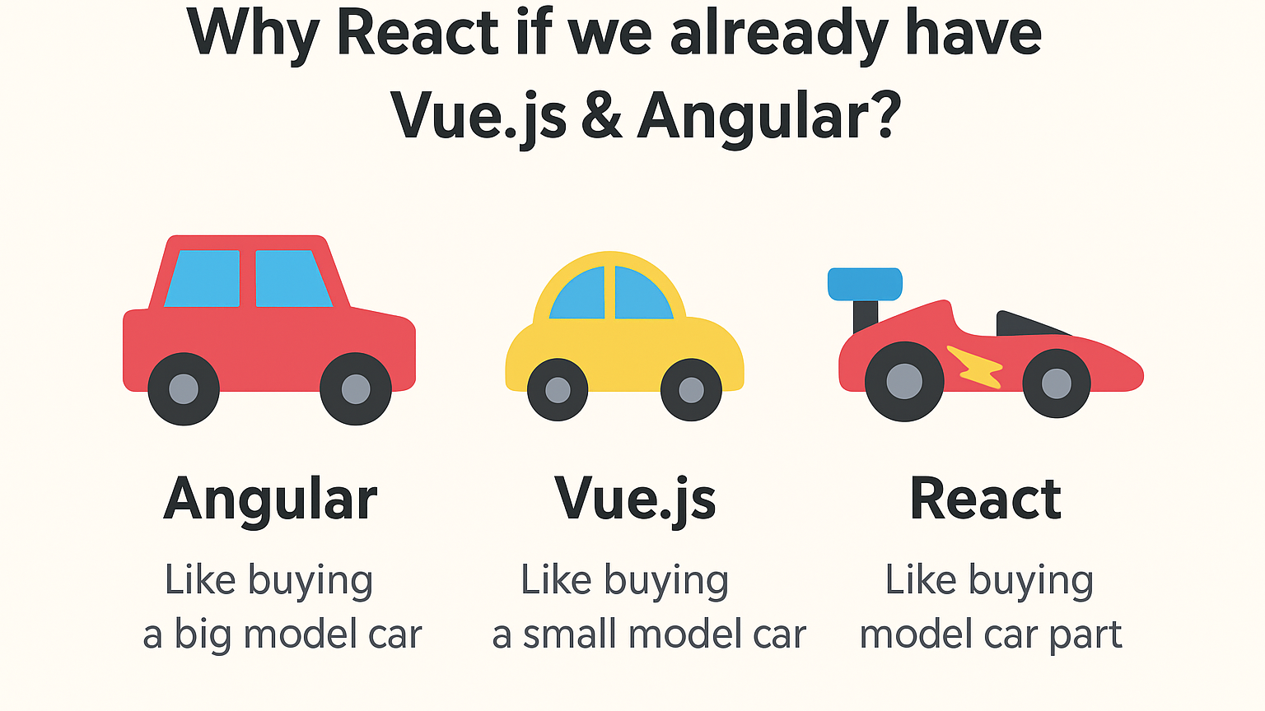
Slide Title, Segoe UI, 24pt, Max. 2 Lines

Slide 20
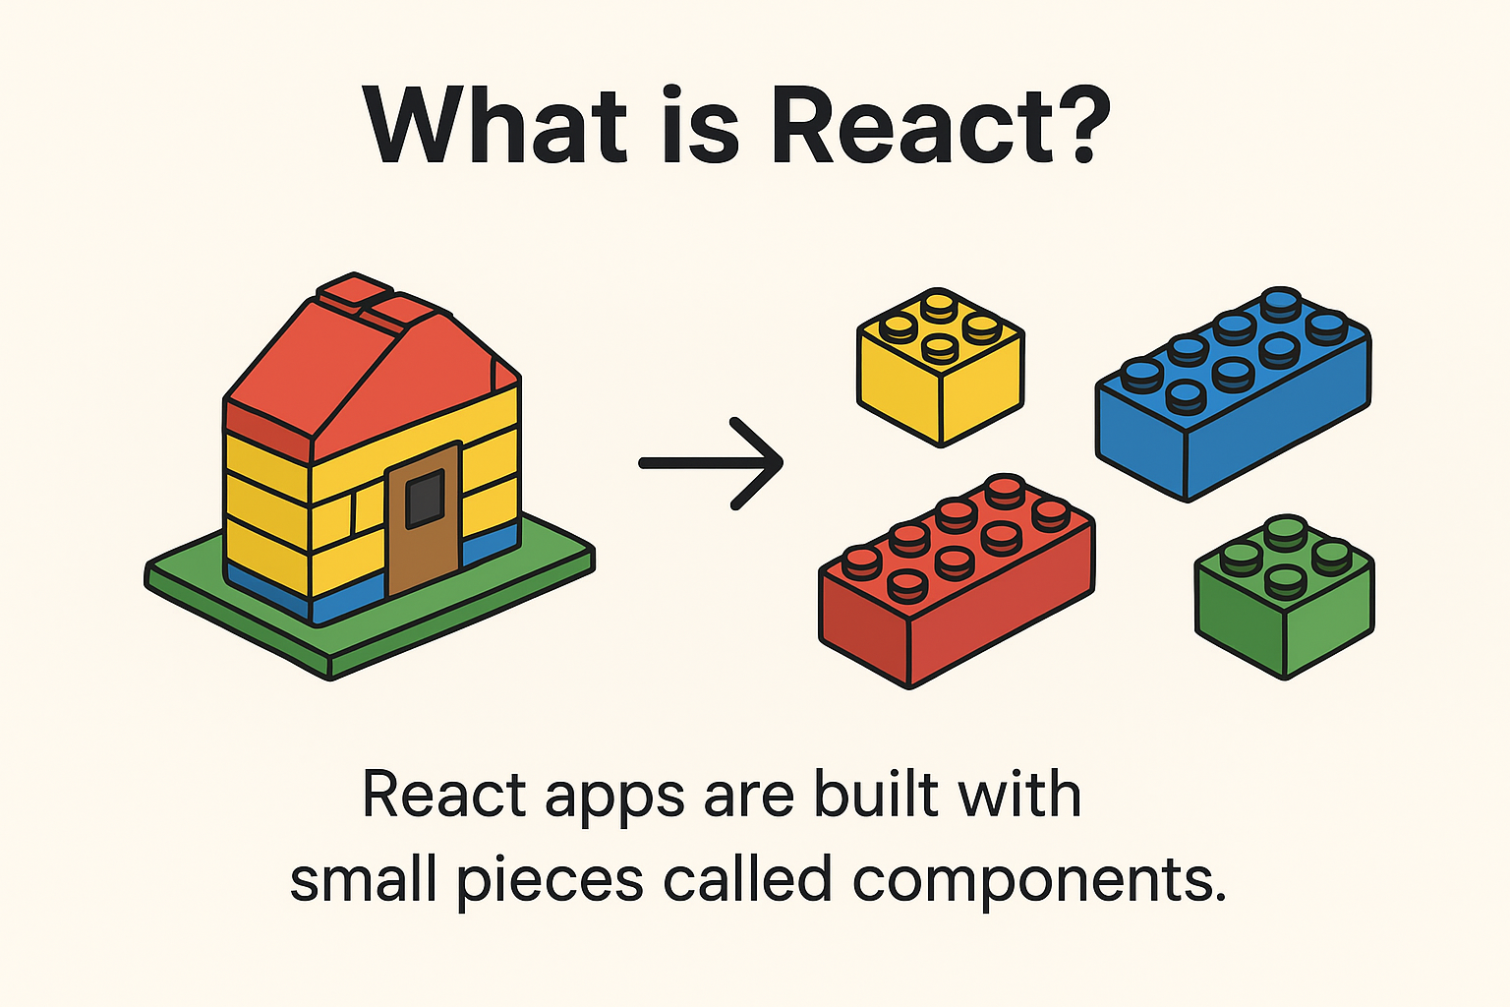
Introduction to react

Slide 21
Key features
📦 Component-based → Breaks big app into small pieces.
⚡ Fast → React updates only the part of the screen that changes.
🔄 Reusable → Build once, use many times.
🌍 Popular → Used by companies like Instagram, Netflix, Flipkart, etc.
How React works
Break UI into Components → (e.g., Button, Header, Footer).
Write JSX → Code looks like HTML inside JavaScript.
Virtual DOM → React tracks changes and updates only what’s needed.
Render UI → Browser shows updated content instantly.

Slide 22
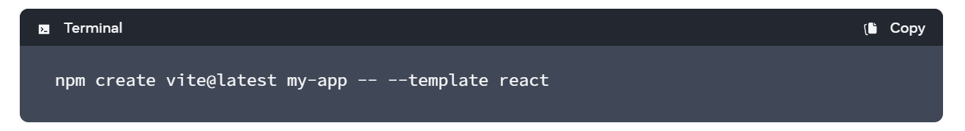
Setting up a React Project with Vite
Prerequisites:
✅ Install Node.js (latest LTS version) → https://nodejs.org ✅ Install a code editor (VS Code).
Create a React Project with Vite
Open VS Code → Open Terminal (Ctrl + ~)
Run this command to create a new app:

Slide 23
Create a react project
Choose options:
- Project name → my-app
- Framework → React
- Variant → JavaScript
Go inside the project folder: cd my-app
Install dependencies: npm install
Start the development server: npm run dev
Open the link (e.g., http://localhost:5173/) in the browser → Your React app is running 🎉

Slide 24
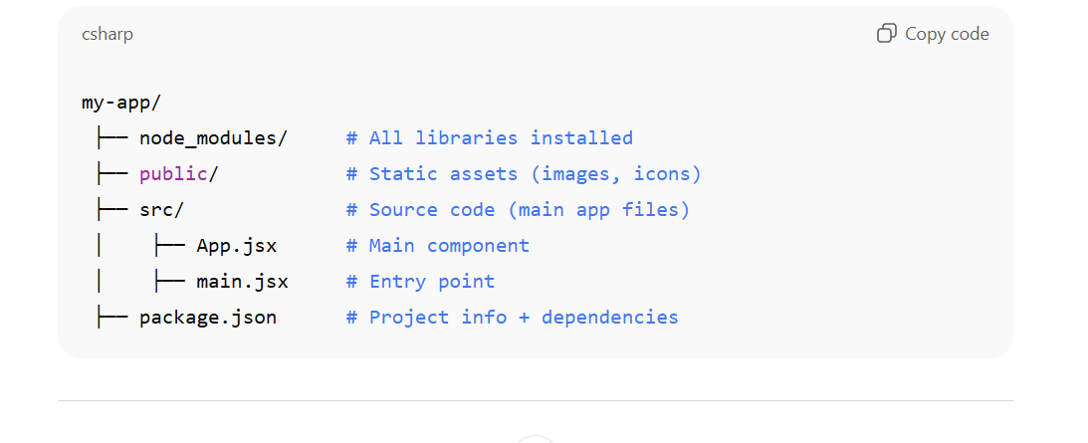
Project structure

Slide 25

Thank you.

